Slide 1
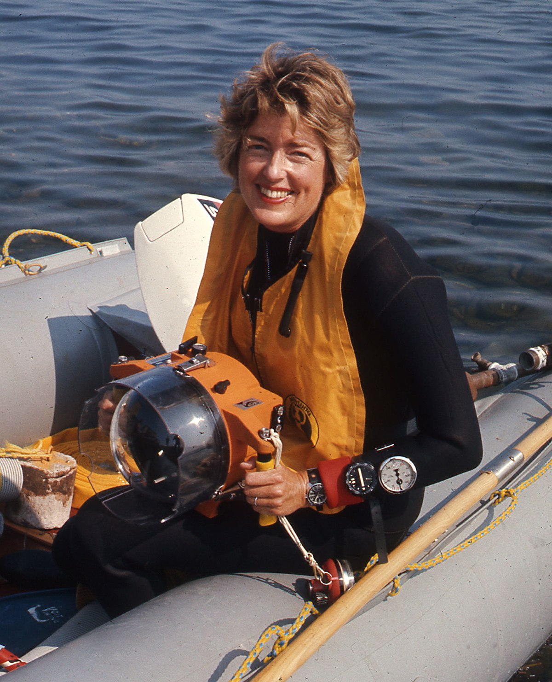
Anna Marguerite McCann
Sophia Patti
Archaeology 323

Slide 2
Background
Born on May 11, 1933 in Mamaroneck, NY
Grew up in Rye, NY
Received a B.A. in Art History with a minor in Classic Greek at Wellesley College
Attended American School of Classical Studies at Athens on Fulbright Fellowship
Received her M.A. from the institute of Fine Arts in NYU
Got her doctoral degree from University of Indiana in 1965

Slide 3
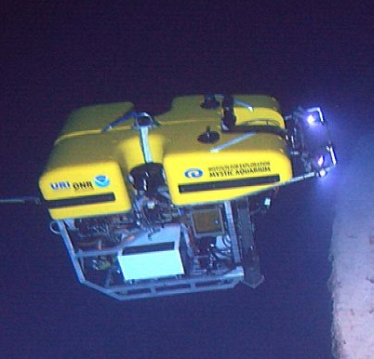
What Is Underwater Archaeology?
Defined as “recovery of information from submerged artifacts and underwater sites for the interpretation of past human cultures” (NPAFC,2020).
Is a processed system of documentation and recovering of lost objects and artifacts that are found in bodies of water.
ROV Hercules
Notes:
According to Marine Protected Areas website, Underwater Archaeology is defined as “recovery of information from submerged artifacts and underwater sites for the interpretation of past human cultures” (NPAFC,2020).
“Is a processed system of documentation and recovering of lost objects and artifacts that are submerged in bodies of water. Sometimes excavation is not necessary since they do not want to disturb the site itself” (NPAFC,2020).
There is use of oceanography and marine biology within underwater arch since many of the objects have to be carefully brought up or studied underwater.
There is also use of ROV/ robotics since many of the sites are too deep for humans to go to.
A example of underwater archaeology with the use of ROV tech is the discovery of the Titanic in 1985.

Slide 4
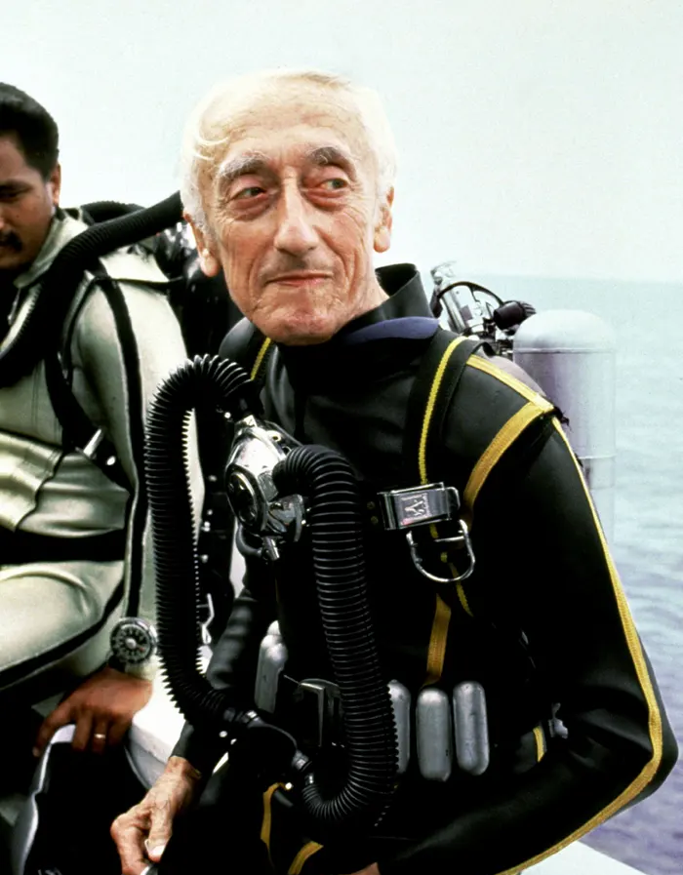
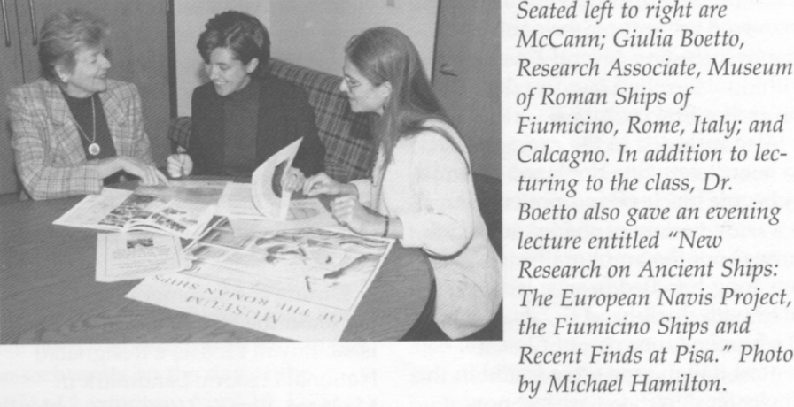
Diving into Underwater Archaeology
In early 1960s, this field was still in its learning stages and male dominated.
worked closely with Jacques-Yves Cousteau and his team on two ancient roman shipwrecks
1961-1962: She was a diver for National Geographic Society & University of Pennsylvania
1963: She did sponsored work by University of Chicago & Indiana University
worked as a photographer for land excavations At the American Academy of Rome
Notes:
In early 1960s, this field was still in its learning stages and male dominated.
worked closely with Jacques-Yves Cousteau and his team on two ancient roman shipwrecks by Grand Congloue, a rocky island off Marseilles harbor.
1961-1962: She was a diver for National Geographic Society & University of Pennsylvania excavation of the Yassi Ada, Turkey.
1963: She worked in port of Kenchreai with a project sponsored by University of Chicago & Indiana University
At the American Academy of Rome, worked as a photographer for land excavations at the hilltops of Cosa; on the coast of Turkey.

Slide 5
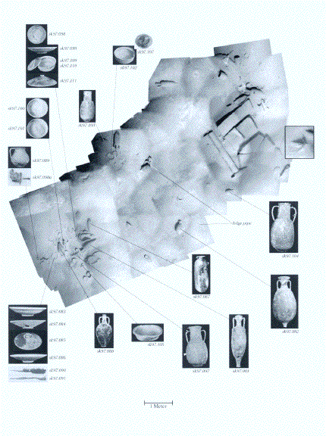
Her Discoveries
1964: McCann was a photographer and found a submerged pier in the sea.
She found that this port had existed during the Roman Republic and was a trading port.
1973 : McCann and her team of divers went to Rome and collaborated with Istituto Internazionale Di Studi Liguri
Mapped and explored ancient harbors of Polonia and Pyrgi alone the Tuscan coast.
In Pyrgi, they discover ancient parts of roman city that had been lost due to earthquakes and was submerged under water.
Examples of Anne Marguerite’s research using the JASON
Notes:
1964: In Cosa, Italy McCann was a photographer and found a submerged pier in the sea. She raised question to the discovery but was ignored.
Raised funds and got granted from University of Missouri to excavate.
She found that this port had existed during the roman republic and was a trading port.
1973 : McCann and her team of divers went to Rome and collaborated with Istituto Internazionale Di Studi Liguri
Mapped and explored ancient harbors of Polonia and Pyrgi alone the Tuscan coast.
In Pyrgi, they discover an ancient part of a roman city that had been lost due to earthquakes and was submerged under water.

Slide 6
Other Remarkable Achievements
McCann taught art history and archaeology at the University of Missouri (1966-1971).
Berkeley, University Of California Professor (1971-1974)
1974: Joined the Metropolitan Museum of Art team to catalog Roman Sculptures
Published her research book called Roman Sarcophagi in the Met
Boston University (1977-2001).
Was awarded the Association of American University Presses’ outstanding book award (1987)
Became Archaeological Director of the Jason Project in 1989.
AIA’s James R. Wiseman Book

Slide 7
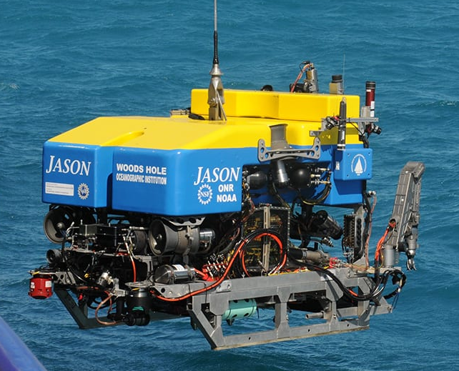
1998: awarded first gold medal of Archaeological Institute of America for her lifetime achievements.
Institute of Technology (2001-2007).
collaborated with Robert Ballard of Woods Hold Oceanographic Institute in Massachusetts.
ROV tech ballard was used when trying to find the Titanic. Used the same technology for trade routes between Carthage and Rome in the Mediterranean.
Jason Project ROV

Slide 8
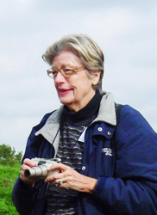
Epilogue
After a lifetime of research and studies, Anna Marguerite McCann died peacefully on february 12th 2017 in Sleepy Hollow, New York. She was 83.

Slide 9
Sources
“Dr. Anna Marguerite McCann.” Boston University Arts & Sciences Archaeology, October 2017, http://www.bu.edu/archaeology/dr-anna-marguerite-mccann/. Accessed 9 March 2021.
“In Memoriam: Dr. Anna M. McCann Taggart '54.” Wellesley College, October 2017, https://www.wellesley.edu/classical/events_and_news/drmccann. Accessed 9 March 2021.
Marine Protected Areas. Underwater Archaeology, Marine Protected Areas, 2020, https://marineprotectedareas.noaa.gov/toolkit/underwater-archaeology.html. Accessed 9 March 2021.
Oleson, John Peter, and John Pollini. “Anna Marguerite McCann.” AJA Online, October 2017, https://www.ajaonline.org/sites/default/files/1214_Oleson_0.pdf. Accessed 9 March 2021.

